Slide 1
IOT-BASED ELECTRIC VEHICLE AUTO PARKING SYSTEM
Submitted by:
L.R.Sowmidra

Slide 2
INTRODUCTION:
It is designed to effortlessly guide the vehicle into the perfect parking spot while minimizing energy consumption and maximizing convenience.
It refers to the integration of technology to optimize the management of parking spaces. It typically involves sensors, and software to monitor and manage parking availability, provide real-time information to drivers about vacant spots, and streamline the parking process through automation and data analysis.

Slide 3
Need for smart parking
Assist drivers in parking their vehicles efficiently and accurately, minimizing the risk of damage or injury during parking.
Optimize parking space usage, allowing for more vehicles to be parked in a given area.
Enhance the overall parking experience, making it more convenient, stress-free, and accessible for drivers

Slide 4
Integrate with other smart city infrastructure and mobility solutions, contributing to a more efficient and sustainable urban transportation ecosystem.
Provide real-time parking availability information and guidance, reducing congestion and emissions caused by drivers circling around looking for parking spots

Slide 5
Components
Esp8266(nodemcu)
Ir sensors
Servo motors
Jumper wires

Slide 6
Nodemcu:
NodeMCU is an open-source firmware and Internet of Things) devices. It's based on the ESP8266 Wi-Fi module and allows you to easily program microcontrollers with Lua scripting language or Arduino IDE. It's quite popular for its ease of use and versatility in IoT projects.
Ir sensors:
IR sensor involves detecting infrared radiation emitted or reflected by objects in its field of view. When an object enters the sensor’s range, it absorbs or reflects the emitted infrared radiation, causing changes in the sensor’s output. This change is then converted into an electrical signal, which is processed to trigger specific actions, such as activating an alarm, turning on lights, or controlling a device

Slide 7
Servo motor:
A servo motor works by receiving control signals from a device, such as a microcontroller or a computer, to accurately position its shaft. It consists of a motor, a control circuit, and a feedback system.
Jumper wires:
A jumper wire is a short electrical wire used to create a temporary electrical connection between two points on a circuit board or between components in an electronic circuit

Slide 8
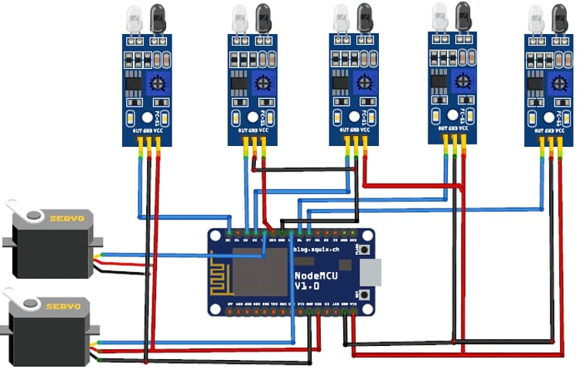
CIRCUIT DIAGRAM:

Slide 9
WORKING:
Now a days finding parking in busy areas is very hard and there is no system to get the details of parking availability online. Imagine if you can get the parking slot availability information on your phone and you don’t have roaming around to check the availability
So here we are building with NodeMCU, five IR sensors, and two servo motors. Two IR sensors are used at entry and exit gate to detect the car while three IR sensors are used to detect the parking slot availability.
NodeMCU controls the complete process and sends the parking availability and parking time information.
Two IR sensors are used at entry and exit gate so that it can detect the cars at entry and exit gate and automatically open and close the gate.
The servo motor automatically rotates from 45° to 140°, and after a delay, it will return to its initial position.

Slide 10
Advantages:
Convenience
Space optimization
Safety
Efficiency

Slide 11


